Slide 1

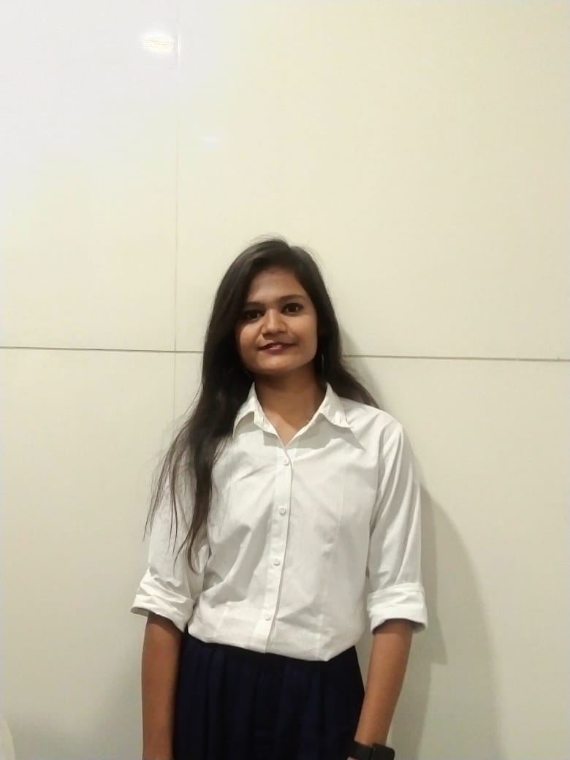

IPL score and winner predictor
Program Feedback
Project Short Summary
The program clearly outlines the goal of using data analytics and machine learning for real-time. Also use of cloud computing overall it was amazing program to learn new things which are required in todays field of technology.
In this project, we aim to develop a machine learning model that can predict the scores and the winner of IPL matches. We will use a dataset containing historical data of IPL matches including batting and bowling statistics, venue, and weather conditions. The dataset will be preprocessed and cleaned to remove any missing or irrelevant data. We will then use various machine learning algorithms such as regression and classification to build models that can predict the scores and the winner of IPL matches.
Anjali Rakesh Yadav
anjaliyadav13500@gmail.com
Final Project Outcome Screenshot
Shri vile parle kelvani mandal institute of technology dhule
#skillsbuild

Slide 2
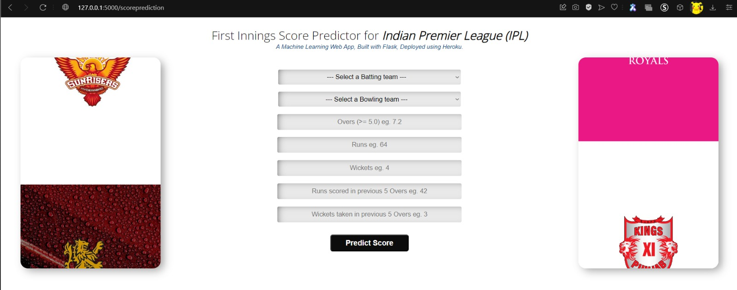
FINAL PROJECT OUTCOME SCREENSHOT

Slide 3
